Slide 1
Metadata

Slide 2
Metadata
metadata = information that describes or augments the main data
displaying format
processing instructions
memory storage details
in-band representation embeds metadata in data itself normally done by using special characters (metacharacters)
the NUL termination in C strings, ’/’ in a file path, ’.’ in a host name, ’@’ in an email address etc.
advantages: more compact and human readable
disadvantages: security problems generated by overlapping trust domains (i.e. data and metadata placed in the same trusted domain)
out-of-band representation keeps metadata separate from data and associate them
string types in programming languages like C++, Java etc.
security problems occur if input data containing metacharacters is not correctly sanitized

Slide 3
Metadata - Embedded Delimiters
vulnerabilities are generated if the attacker can introduce (additional) delimiter characters and input format is not checked ⇒ injected delimiter attacks if input is not sanitized
Example: let us consider a file format like “username:password”, with ’:’ and ’\n’ as delimiters if a “john” user could provide a password like “my_pass\nattacker:attacker_pass\n” the user-password file would look like
john:my_pass
attacker:attacker_pass
Code review:
identify code dealing with metacharacter strings
identify the specially handled delimiters
identify and check any filtering performed on input
⇒ any unfiltered delimiter could lead to a vulnerability

Slide 4
Metadata - Embedded Delimiters
vulnerabilities are generated if the attacker can introduce (additional) delimiter characters and input format is not checked ⇒ injected delimiter attacks if input is not sanitized
Example: let us consider a file format like “username:password”, with ’:’ and ’\n’ as delimiters if a “john” user could provide a password like “my_pass\nattacker:attacker_pass\n” the user-password file would look like
john:my_pass
attacker:attacker_pass
Code review:
identify code dealing with metacharacter strings
identify the specially handled delimiters
identify and check any filtering performed on input
⇒ any unfiltered delimiter could lead to a vulnerability

Slide 5
NUL Character Injection

Slide 6
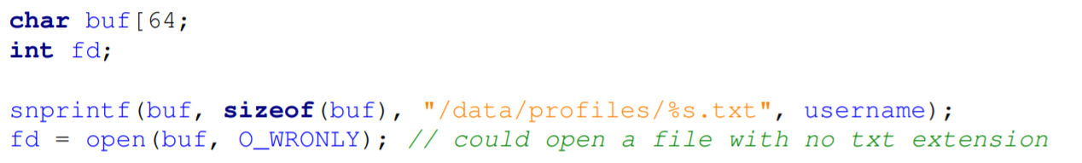
Truncation
it is about cases where a limit exceeding buffer is truncated to avoid buffer overflow

Slide 7
Truncation
the username vulnerable required length could be provided using contiguous slashes (’////’) or repetitive current directory entry (“././././”)

Slide 8
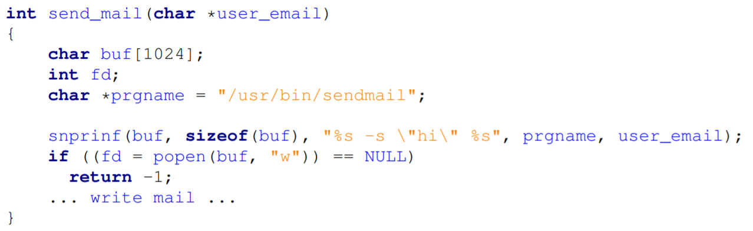
Shell Metacharacter Injection

Slide 9
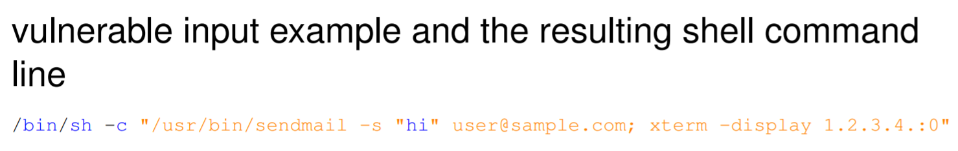
Shell Metacharacter Injection

Slide 10
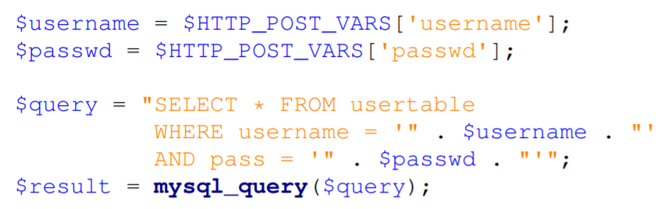
SQL Queries (SQL injection)

Slide 11
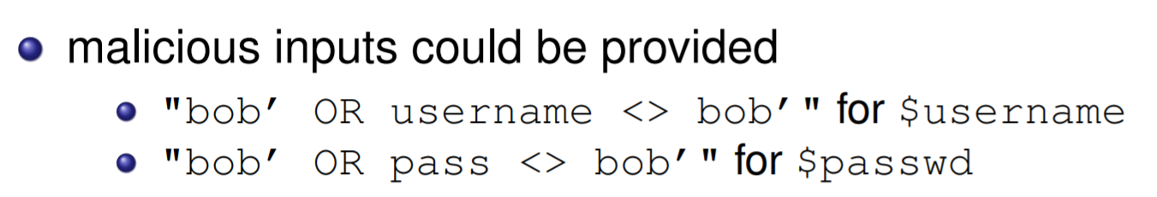
SQL Queries (SQL injection)

Slide 12
Eliminating metacharacters
Checking all illegal character and reject it
Replace illegal characters
Whitelist vs blacklist

Slide 13
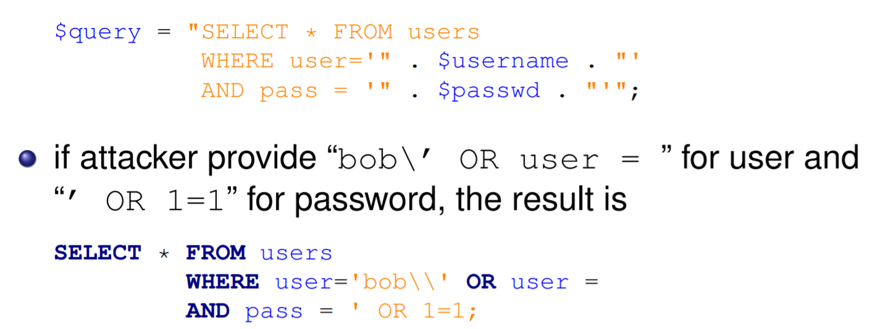
Escaping metacharacters

Slide 14
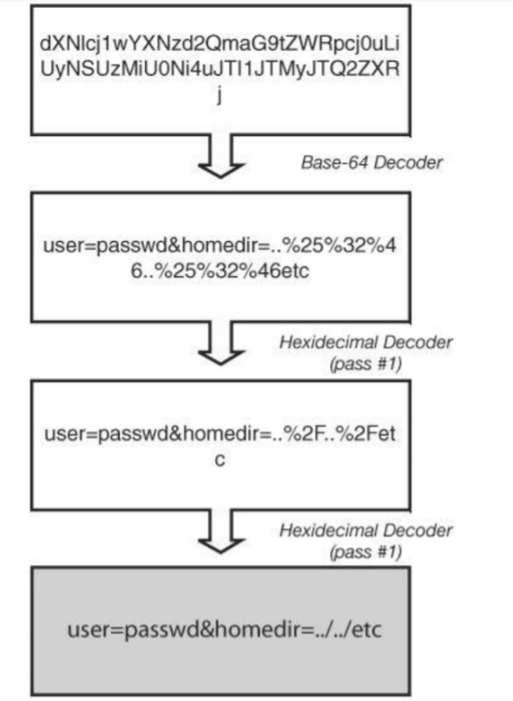
Escaping metacharacters

